Slide 1
Changing Combinations on a Security Container
Lockheed Martin Missiles and Fire Control
FISWG
April 12, 2017

Slide 2
What we will cover…
How to change a combination
Reasons for changing a combination
Additional items to consider

Slide 3
Changing the combination

Slide 4
Lock Requirements
All new locks must meet the FF-L-2740 Federal Specification
Currently there are only two manufacturers and two locks being produced that meet this specification
Kaba-Mas X-10
X-07, X-08 & X-09 while no longer produced can still be used
Sargent & Greenleaf 2740B

Slide 5
X09 / CDX09 Locks

Slide 6
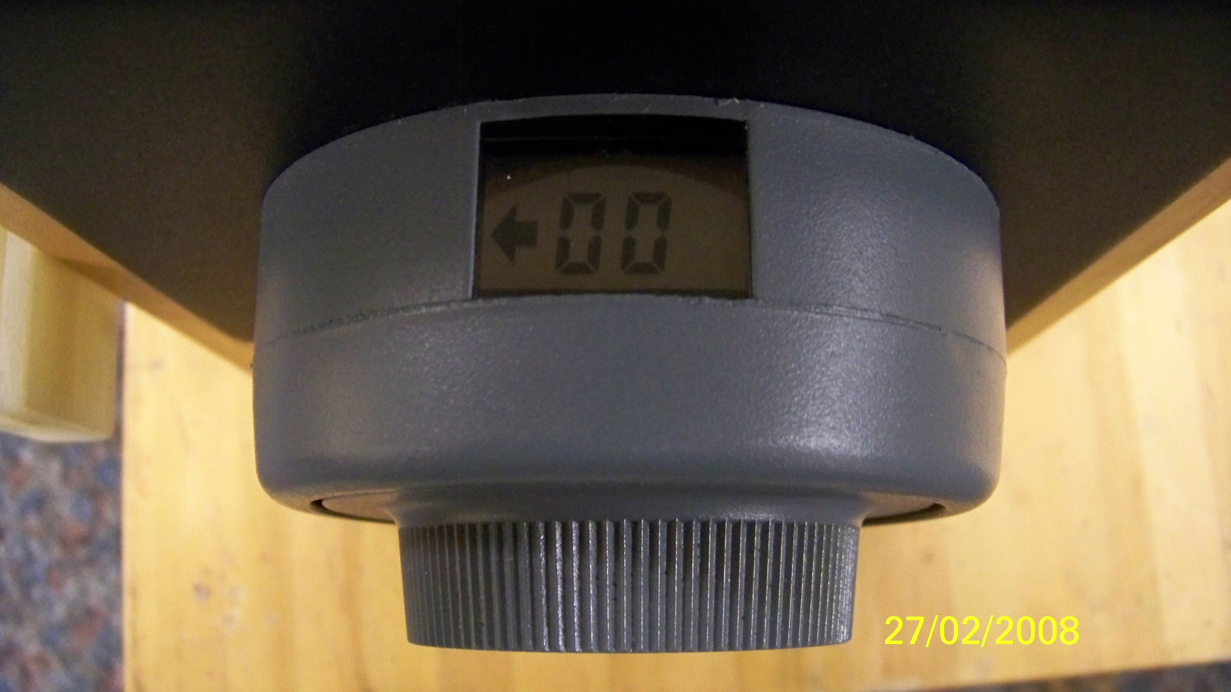
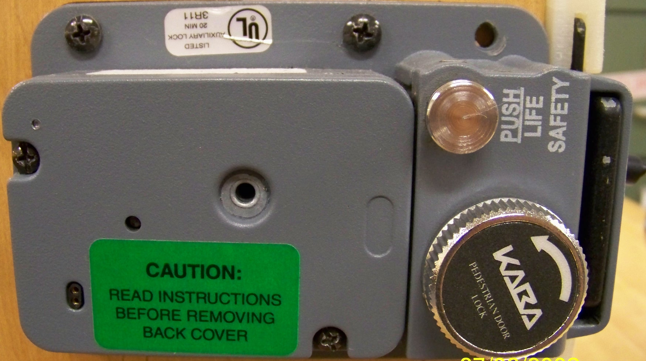
Changing The Combination
Start by opening the container or door. Insert the “change key” on the back of the lock. Trip the latch.
The display will show a “KEY SYMBOL”. Dial the current combo then select the option for SL 1. The display will show “EC”. Enter new combo L, R, L one time in each direction. The new combo will flash each number in the display twice and finally flash “PO”. Pull out the “change key”. “CC” will be displayed (new current combo).
Trip the latch (do not secure the door/container) and open the lock. Do this three (3) times successfully prior to securing the door/container.
“CDX09/X09 Change Key”

Slide 7
X10 / CDX10 Locks

Slide 8
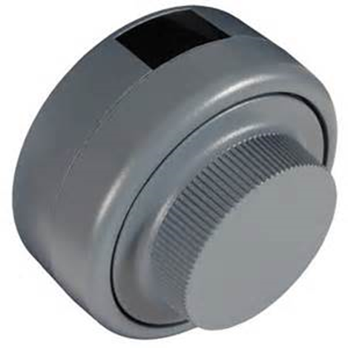
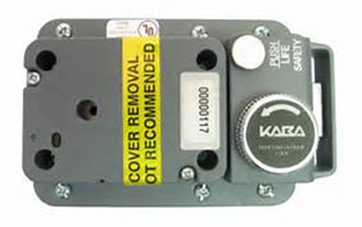
Changing The Combination
Start by opening the container or door. Insert the “change key” on the back of the lock. Trip the latch.
The display will show a “KEY SYMBOL”. Dial the current combo then select the option for SL 1. The display will show “EC”. Enter new combo L, R, L one time in each direction. The new combo will flash each number in the display twice and finally flash “PO”. Pull out the “change key”. “CC” will be displayed (new current combo).
Trip the latch (do not secure the door/container) and open the lock. Do this three (3) times successfully prior to securing the door/container.
“CDX10/X10 Change Key”

Slide 9
X09/X10 differences
X10 has a backlit display making it easier to read
Lock is now a sealed unit. No lock on back cover (LOBC) pin required
After dialing the combination and getting to “OP” while turning to the right you will hear a motor retracting the bolt, continue to turn until the dial stops spinning

Slide 10
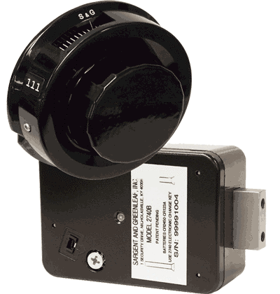
Sargent & Greenleaf 2740B Lock

Slide 11
Changing The Combination
Start by opening the container or door. Insert the “change key” on the back of the lock, it only plugs into the cover one way. Trip the latch.
The lock will emit one quick beep when you begin to enter your old combination. You now have two minutes to complete the following steps.
Enter the existing combination to the index making sure that you turn the dial left at least two complete revolutions, then stop precisely on the first number, turn the dial right (clockwise), stopping when the second number turn the dial left, stopping when the third, then turn the dial right until you hear three quick beeps from the lock.
Turn the dial left (counterclockwise) at least two complete revolutions, then stop when the first number of the NEW combination comes to the index, turn the dial right (clockwise) until the second NEW combination number, turn the dial left until the third NEW combination number, then turn the dial right until you hear three quick beeps from the lock.
The new combination is entered again for verification. Repeat the above step. After reaching the third number turn the dial right, listening for five quick beeps to indicate a successful combination change. If the lock is in single user mode, continue turning the dial right to retract the lock bolt. If the lock is in dual user mode, simply stop dialing.
Remove the change key from the lock.
Trip the latch (do not secure the door/container) and open the lock. Do this three (3) times successfully prior to securing the door/container.

Slide 12
Unique features of the S&G 2740B
The change key only plugs into the lock cover one way. When the orientation is correct, the arrow on the end of the connector will align with the arrow molded into the lock case.
Between combination entries, the lock emits a series of quick beeps as the dial is turned clockwise. You should stop turning clockwise when the three beeps sound.
If you begin a combination change and then decide not to proceed with it, you can simply wait two minutes for the change function to time out. At the end of the two minutes, one long beep will sound.
If your lock is in single user mode and you accidentally close the door with the change key in the lock, you can open it by going through the entire combination change procedure, beginning with step 4, using the last successfully set combination as the “OLD” combination.

Slide 13
When do combinations have to be changed?

Slide 14
Combination Changes
Combination Changes (5-309)
The initial use of an approved container or lock for the protection of classified material
The termination of employment of any person having knowledge of the combination, or when the clearance granted to any such person has been withdrawn, suspended, or revoked
The compromise or suspected compromise of a container or its combination, or discovery of a container left unlocked and unattended
At other times when considered necessary by the FSO or CSA
Combinations are classified to the level of the material stored within and must be committed to memory (5-308)
Ensure only the minimal number of authorized personnel have knowledge of the combination
A record of the names of persons having knowledge of the combination shall be maintained
Combinations shall be safeguarded in accordance with the highest classification of the material stored in the container
If a record is made of the combination the record shall be marked with the highest classification of the material authorized to be stored in the container
Use “word association” to create combinations that will be stronger but easier to remember (example MICKEY would be 64-25-39)

Slide 15
Additional combination change information

Slide 16
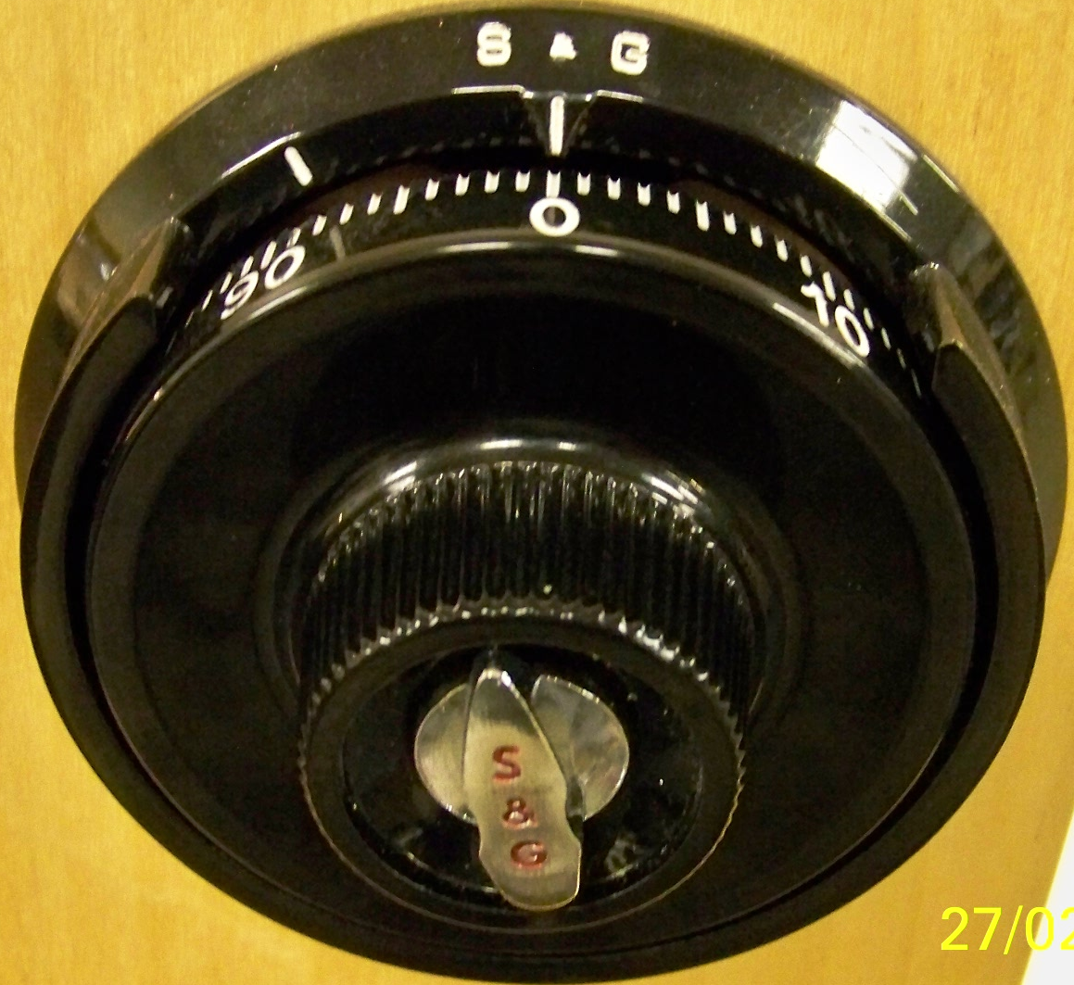
S&G 8400 & 8500 Locks
S&G 8400
S&G 8500

Slide 17
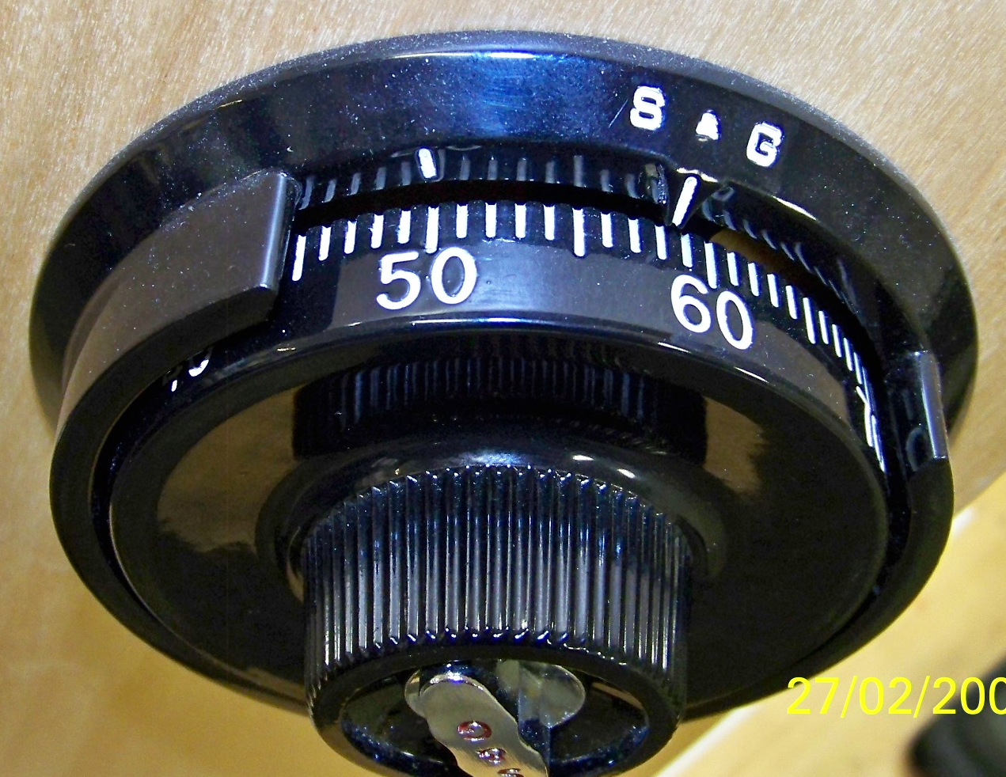
Changing The Combination
The combos must be aligned on the change index mark NOT the open index mark.
Do NOT return to “0” after the last number. Insert the “change key”.
“Open” Index Mark
“Change” Index Mark
“S&G Change Key”

Slide 18
Changing The Combination (cont)
Always perform this change with the door/container open.
The “change key” is inserted in the back of the lock while the last digit of the combination is set on the “change index mark”.
Once inserted, turn the “change key” to the right until it stops.
Dial the new combination (slowly) on the “change index mark”, stopping on the last number.
Turn the “change key” counter-clockwise and remove.
Dial the new combination on the “open index mark”. Do this three (3) times successfully prior to securing the door/container.

Slide 19
Mosler 302 Hand Change Locks

Slide 20
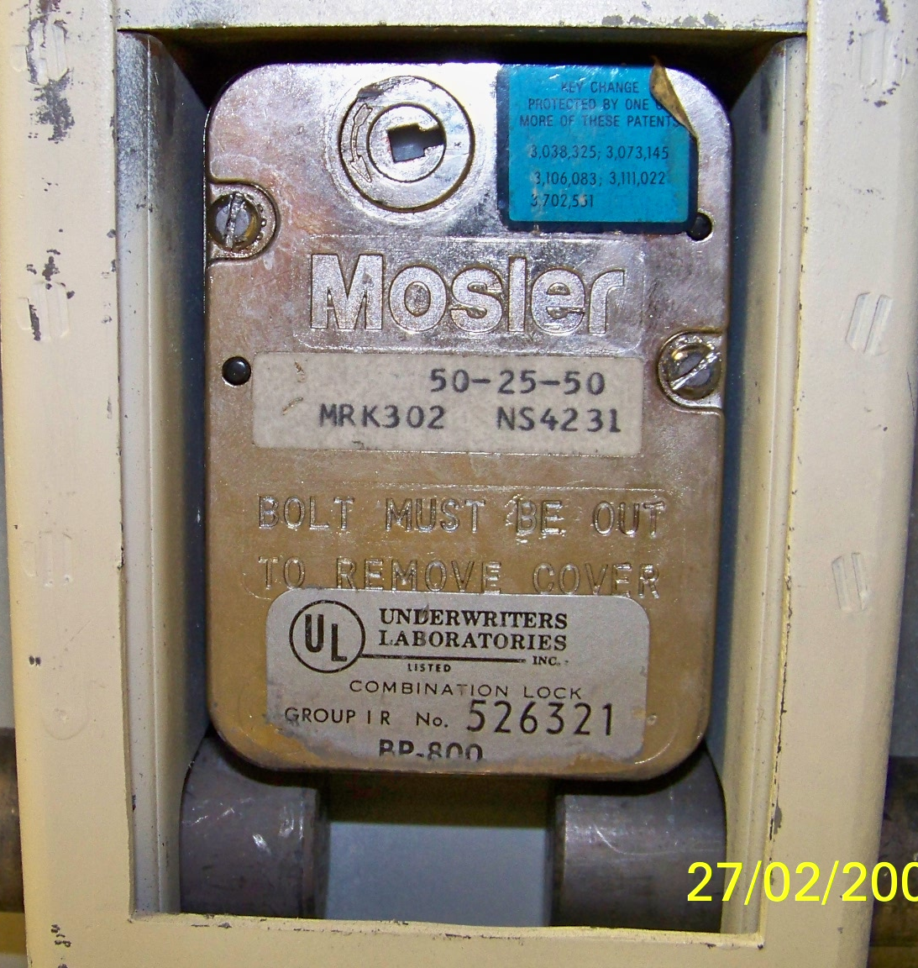
Changing The Combination
Start by opening the container and remove the back plates from the back of the drawer front. Ensure the latch/bolts are released/secure after the drawer is opened.
Remove the two (2) screws holding the lock back plate, spin-off the dial to the right. The combo pack should fall into your hand.

Slide 21
Changing The Combination (cont)
Remove the “c-clip” from the hub.
Remove the discs and spacers and place on a work surface in the order they are removed (i.e. combo face-up).
Inspect each disc for cracks/breaks. If present, do NOT re-use this lock pack and contact the locksmith.
The last disc removed represents the 1st number in the combo, the middle disc represents the 2nd number, and the last disc represents the 3rd number.
Remove the center hubs of each disc and rotate the index mark to the “new number” of the combo for each disc.

Slide 22
Examples of Defective Combo Discs
If any of the discs have this issue and a replacement cannot be located, the entire lock will have to replaced with a “X Series” lock. Keep in mind that considerable time will be required to procure and install a new lock.

Slide 23
Mosler 302 Key Change Locks

Slide 24
Changing The Combination
Start by opening the container and remove the back plates from the back of the drawer front. Ensure the latch/bolts are released after the drawer is opened.
Dial the existing combination on the “change index mark”, stopping on the last number (do not go to “0”).
Insert “change key” fully and turn clockwise until it stops.
Dial new combo on the “change index mark”, stopping on the last number. Turn the “change key” counter-clockwise until it stops and remove.
Dial the new combo on the “open index mark” as normal.
Do this three (3) times successfully prior to securing.
“Mosler 302 Change Key”

